Slide 1
Metadata Based Indexing and Document Searching in eDiscovery
Rahul Bhoopalam (rbhoopalam@ufl.edu)
Subodh Nimkar (nimkarsubodh@ufl.edu)

Slide 2
E-discovery
Refers to discovery in civil litigation which deals with the exchange of information in electronic format
Includes all electronic information such as:
Word documents
Spreadsheets
Emails
Audio and Video
Time Consuming and Expensive process
Volume of data
Unstructured Nature of Data
Notes:
Even a seemingly routine legal matter can produce an astonishing number of documents.
Email messages, word processing files, spreadsheets, legal agreements, memos.
More computer users -> exponentially growing electronic records.
Persistent storage -> records remain indefinitely.
In a business dispute, what determines the outcome is the ability to analyze documents. Quickly finding “smoking gun” documents – the opponent’s or ones own – allows one to adopt the most advantageous legal strategy and obtain the most favorable results.

Slide 3
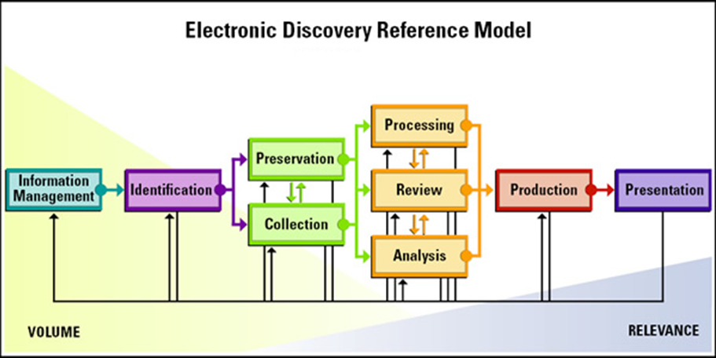
E-discovery Process
Notes:
Identification - potentially responsive documents ( date range ? Etc )
Preservation, Collection – Legal HOLD, Company to legal council
Production – Turning over docs to opposing council.

Slide 4
Motivation
Developing a software that would allow users to discover relevant electronic documents.
Phases in eDiscovery: Identification , Preservation, Collection, Processing, Review, Production
Processing and Review Phases:
Rapid identification of potentially relevant documents.
Requires efficient indexing algorithms
Culling of documents according to various criteria
Users must be provided with simple ways to perform faceted searches (filter documents by choosing specific Metadata attributes).
Notes:
Processing -> deduplication and de-NISTing ( removing system files )

Slide 5
Existing Technologies
LegalMine from Dorsey, EnCase from Guidance Software, Catalyst
Apache Solr – A standalone enterprise search server with a REST-like API.
Documents are put in it via XML, JSON, CSV or binary over HTTP.
Queries are via HTTP GET.
Results in XML, JSON, CSV or binary.
Apache Lucene – full-featured text search engine library written entirely in Java.
best suited for desktop applications and hence is our choice for indexing.
pyLucene : a python wrapper for Apache Lucene
Notes:
Proprietary software

Slide 6
Data/Algorithms Used
Data set
Enron Email Dataset
http://www.cs.cmu.edu/~enron/
500,000 messages in the form of e-mails.
Algorithms
Indexing
Apache Lucene for metadata based indexing.
Ranking ( Currently exploring the potential ones )
IntervalRank
http://www.stat.berkeley.edu/~tsmoon/files/Conference/wsdm2010.pdf
AdaRank : Boosting Algorithm for Information Retrieval
http://research.microsoft.com/en-us/people/hangli/xu-sigir07.pdf
RankLib: Java library of ‘learning to rank’ algorithms
Notes:
Enron Data set contains data from about 150 users, mostly senior management of Enron, organized into folders.
IntervalRank -> Pointwise, pairwise and listwise approaches
AdaRank -> repeatedly constructs ‘weak rankers’ on the basis of re-weighted training data and finally linearly combines the weak rankers for making ranking predictions.

Slide 7
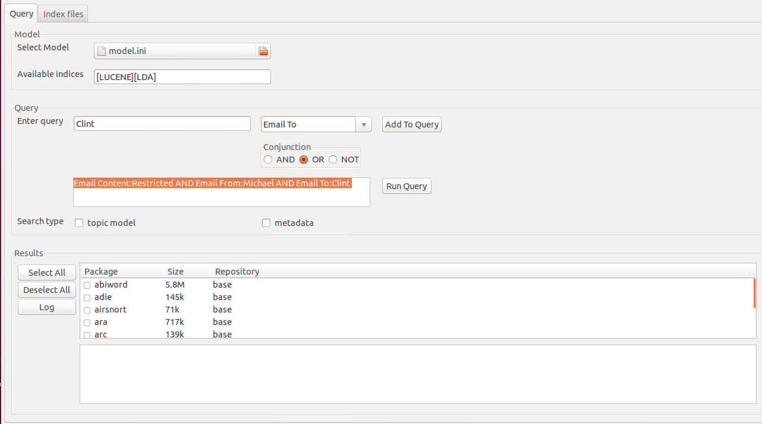
Initial Results

Slide 8
Next Steps
Finalize the ranking algorithm based on the metrics decided.
Augmenting the search capability for
more document types such as PDFs and Word documents.
additional metadata attributes.
Ensuring an easy-to-use UI for query-formulation and result-visualization.

Slide 9
Innovation
The document-ranking algorithm proposed to be implemented would progressively learn with every search, by collecting relevancy scores from the user.
Platform-independent, user-feedback-based mechanism to establish the ranking of documents.
Lucene based document indexing.
Notes:
Highlights of our project

Slide 10
Responsibilities
Subodh
Ranking algorithm ( Literature Survey )
UI to visualize the search results
Rahul
Ranking algorithm ( Literature Survey )
Lucene Indexing & UI for Query Builder
Subodh & Rahul
Implementation of the Ranking algorithm

Slide 11
THANK YOU

